Slide 1
STAT 717: Lecture 3
Multivariate Normal Density Function
Vitaly Druker
September 10th, 2021

Slide 2
Multivariate Normal Density Function

Slide 3
Features of MVN Density Function
Distribution can be completely described using only means, variances and covariances (covariance matrix)
Bivariate plots show linear trends
If variables are uncorrelated they are independent
Why is this the case and how is it different than what we said before
Even when the data are not multivariate normal – the mvn normal may serve as a useful approximation by the central limit theorem

Slide 4
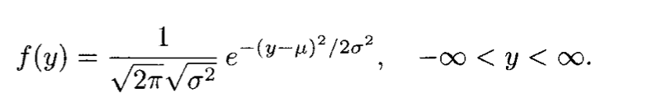
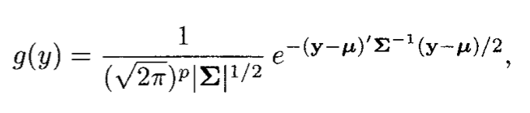
Univariate Normal Density and MVN

Slide 5
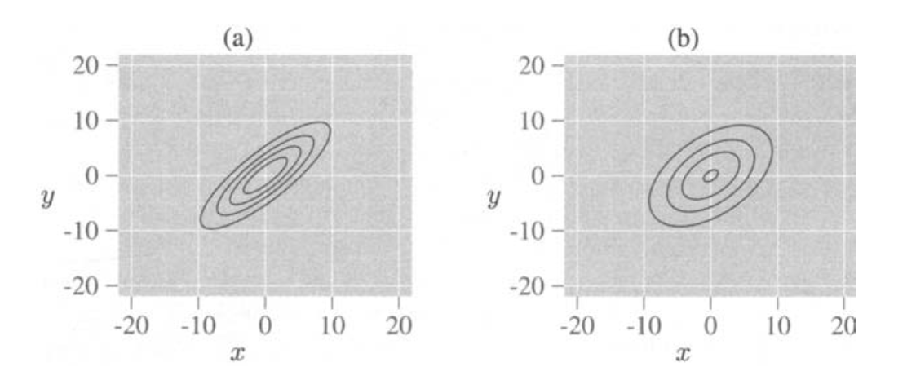
Generalized Population Variance
In the presence of multicollinearity, one or more eigenvalues of Σ will be near zero and |Σ| will be small, since |Σ| is the product of the eigenvalues

Slide 6
Properties of MVN Random Variables

Slide 7
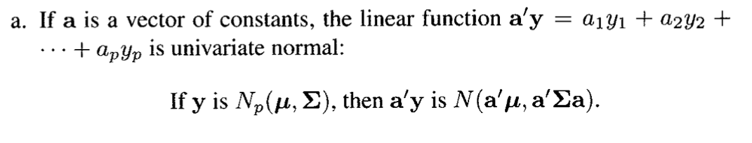
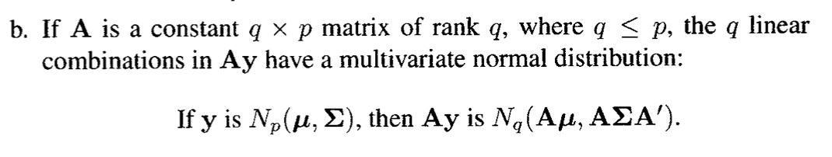
Normality of linear combinations of the variables in y

Slide 8


Standardized Variables
A standardized vector can be obtained in two ways:

Slide 9
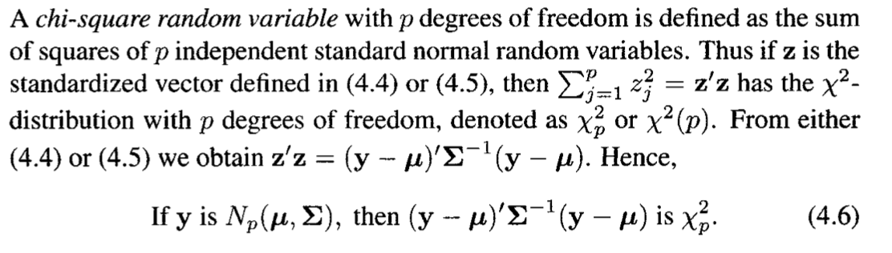
Chi-square distribution

Slide 10
Normality of Marginal Distributions
Any subset of columns are their own multivariate distribution
As a special case, a single column is a univariate normal
The converse of this is not true. If the density of each yj in y is normal, it does not necessarily follow that y is multivariate normal.

Slide 11
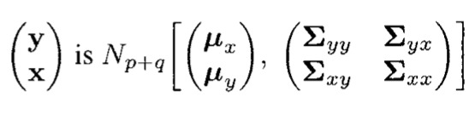
Definitions

Slide 12
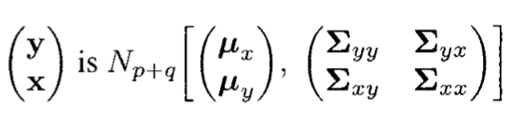
Independence

Slide 13
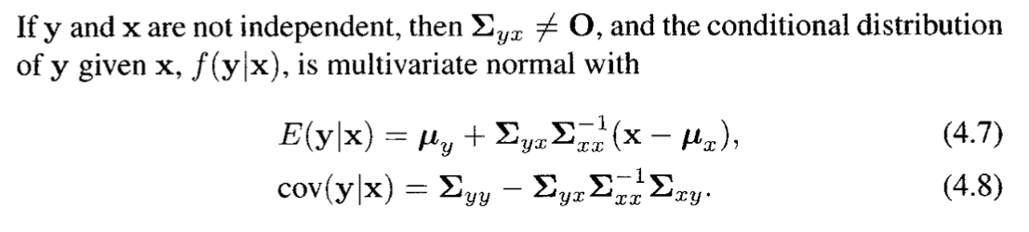
Conditional Distribution

Slide 14
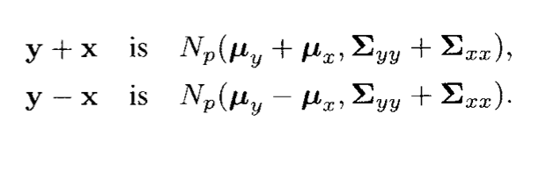
Distribution of the sum of two subvectors
If y and x are the same size:

Slide 15
Estimation in the multivariate normal

Slide 16
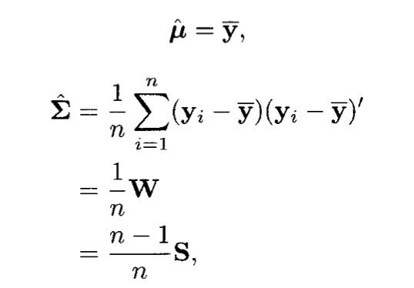
Maximum Likelihood Estimation

Slide 17
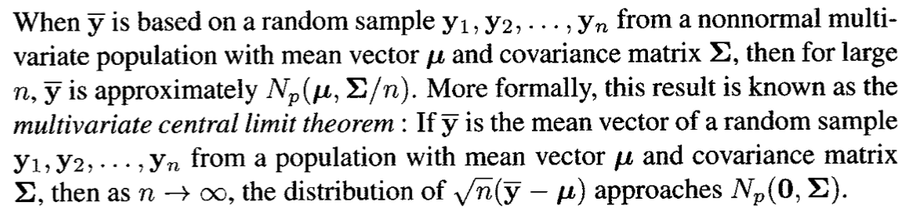
Distribution of y bar

Slide 18
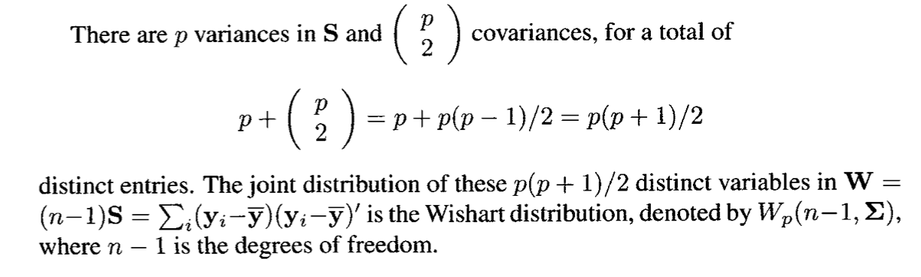
Distribution of S

Slide 19
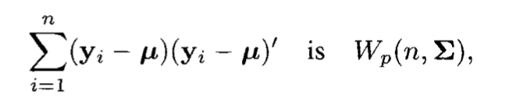
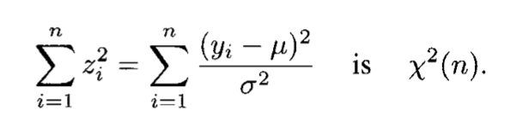
Wishart Distribution cont.
Similar to a Chi square in univariate case

Slide 20
Assessing Multivariate Normality

Slide 21
Investigating Univariate Normality
If one of the random variables in a sample is not normal than the collection cannot by multivariate normal.
QQ Plots are good
Sort the values and compare to theoretical quantiles (see R code)
You don’t have to use the sample mean and standard deviation but it makes reading the curve easier

Slide 22
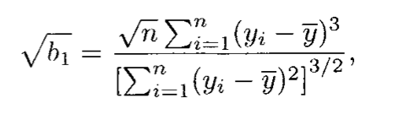
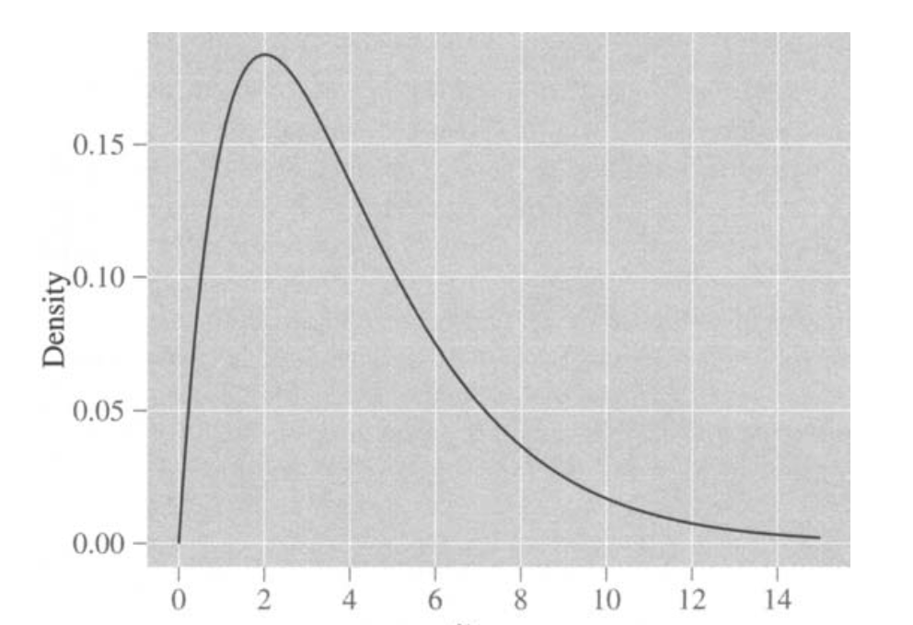
Skewness
If Negative then negative skewness

Slide 23
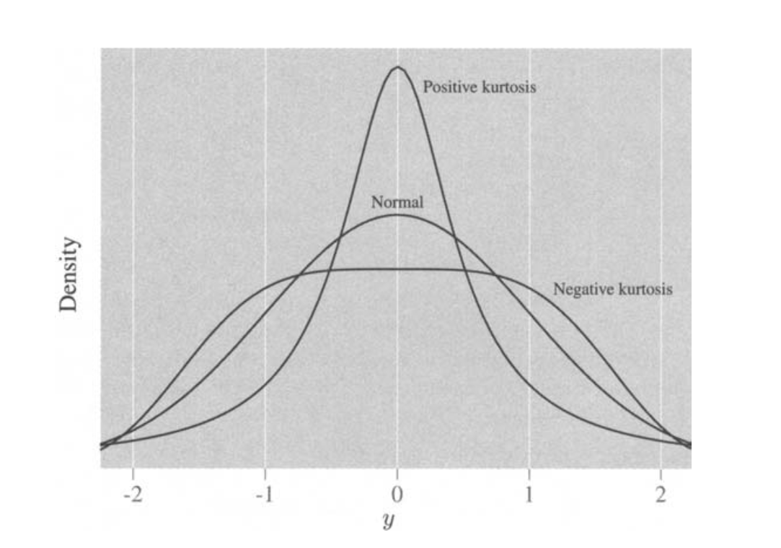
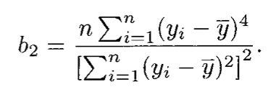
Kurtosis
If < 3 then negative kurtosis

Slide 24
Investigating Multivariate Normality
Scatter plots

Slide 25
Transformations to normality

Slide 26
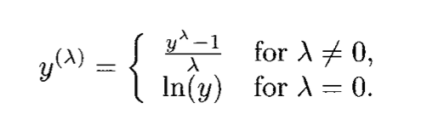
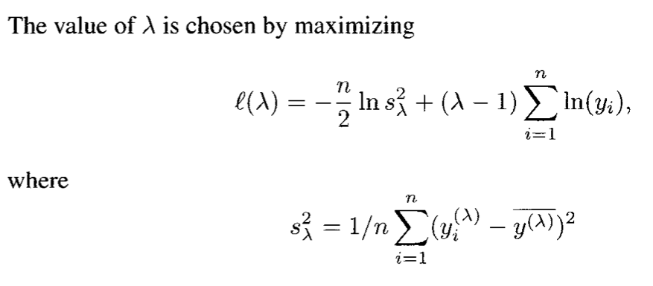
Box Cox

Slide 27
Homework
4.10
4.19
4.26

